Slide 1
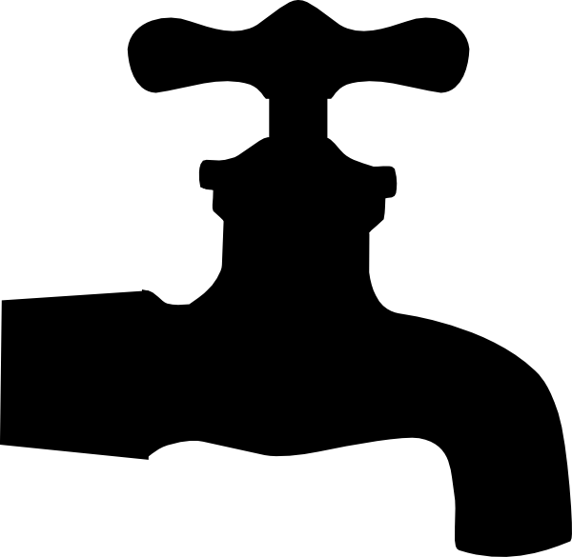
P peline
The Data
Byte 3
© Jennifer Mankoff
The Data Pipeline; HCII; Spring 2014

Slide 2
Introducing the Visualization Byte
jmankoff-viz.appspot.com
Same data set as Byte 2 (explore) [even if it’s your own]
Using D3/Google Charts
Passing data from your python code to JavaScript running in the user's browser
Designing a visualization of your data

Slide 3
Using Google Charts API
https://developers.google.com/chart/interactive/docs/gallery
var data = google.visualization.arrayToDataTable([
['Age', 'Adopted', 'Euthanized'],
['< 6 months', 1000, 400],
['6-12 months', 1170, 460],
['12-5 years', 660, 1120],
['>5 years', 1030, 540]
]);

Slide 4
Using Google Charts API
https://developers.google.com/chart/interactive/docs/gallery
var options = {
title: 'Animal Outcomes based on Age at Arrival',
width: 400, height: 200,
chartArea: {height: '50%'},
hAxis: {title: 'Age', titleTextStyle: {color: 'red'}}
};

Slide 5
How to pass data from python?
Assume the same fake data on the python side:
data = [
['Age', 'Adopted', 'Euthanized'],
['< 6 months', 1000, 400],
['6-12 months', 1170, 460],
['12-5 years', 660, 1120],
['>5 years', 1030, 540]
]

Slide 6
How to pass data from python?
Pass it to the browser:
@app.route('/')
def index():
data = [... # all the stuff above ]
template = JINJA_ENVIRONMENT.get_template('templates/index.html')
return temeplate.render({'data':data})

Slide 7
How to pass data from python?
Parse it on the browser side:
var data = google.visualization.arrayToDataTable({{data|safe}})

Slide 8
Main part of the work
Deciding which charts to use
Writing the loops in your python code to collect your data up in an appropriate format
It is acceptable to use this for a significant part of your byte work

Slide 9
D3 also required
I encourage you to explore D3: More artistic control over presentation; more interactivity possible
Required to have at least one D3 chart
Should NOT look the same as mine – need to improve on either the data you send or the chart type/use.

